Slide 1

ASP.NET 5 And New Tools For Web Developers Oleksandr Krakovetskyi CEO, DevRain Solutions PhD., Microsoft MVP, Microsoft Regional Director
July 05, 2015

Slide 2
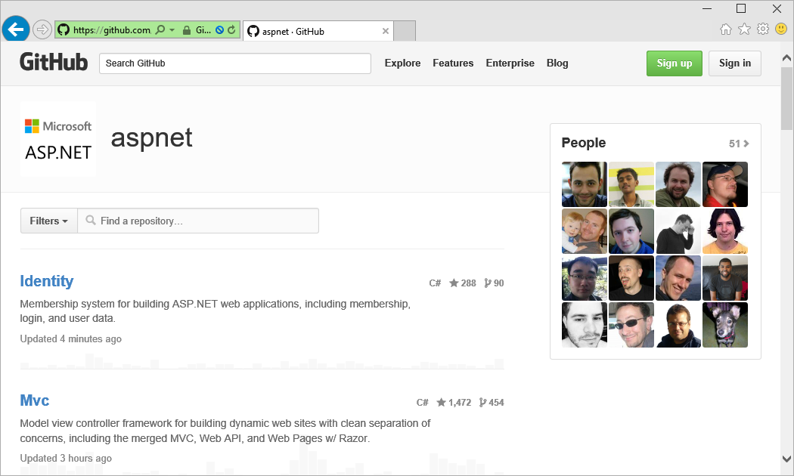
ASP.NET is Open Source
Open Source
https://github.com/aspnet
Real repositories for development

Slide 3
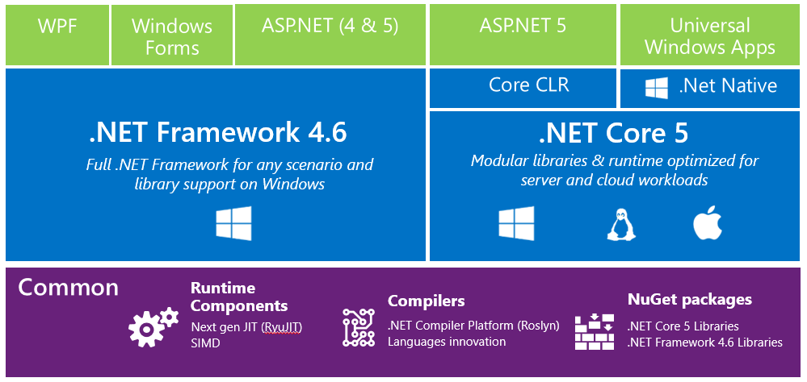
.NET 2015

Slide 4
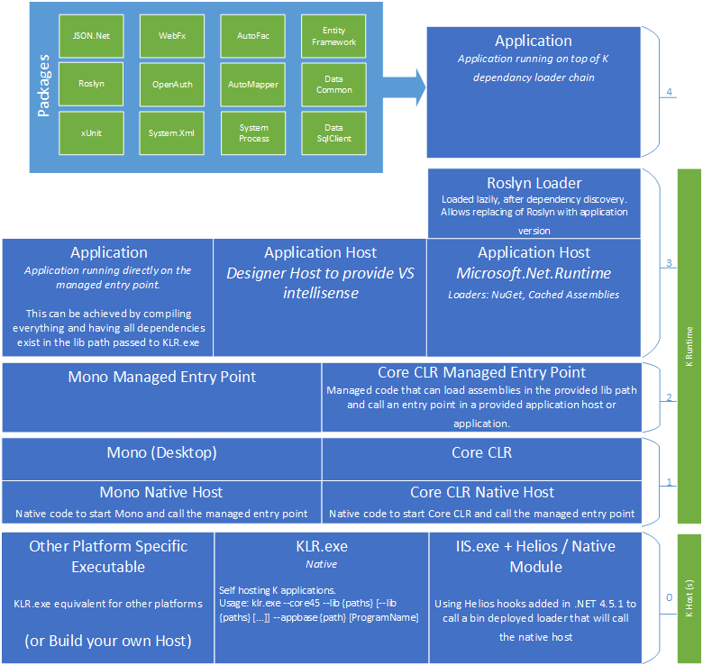
ASP.NET 5

Slide 5
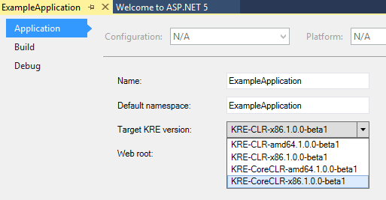
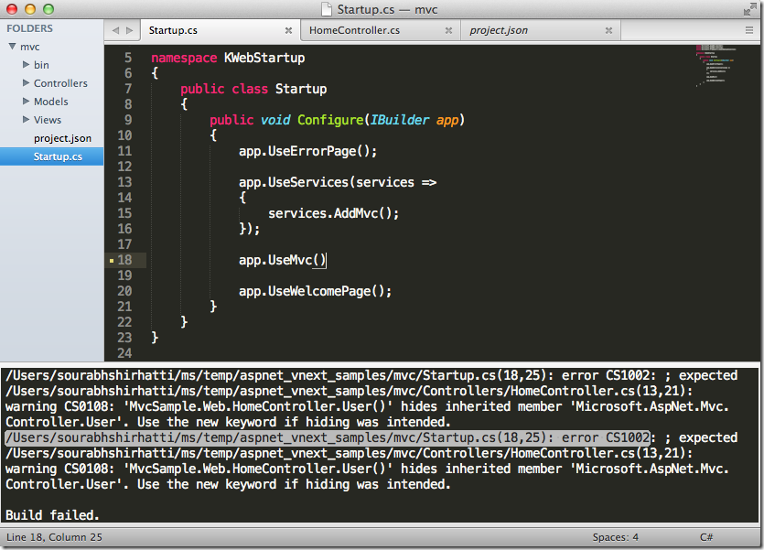
ASP.NET 5
New environment
Full .NET CLR full version, compatibility
Core CLR optimize for cloud
Cross-platform CLR Windows, Linux, OS X
Hosting everywhere
Side by side .NET Core 5 – NuGet package
Self-hosting on any device

Slide 6
ASP.NET WebForms 4.6
Web Forms 4.6:
HTTP 2, Async model bindings, Roslyn
Updated Ajax Control Toolkit
Updated Dynamic Data Framework, Entity Data
Source Control and Universal Providers to work with Entity Framework 6
Updated C# & VB templates with latest packages
http://blogs.msdn.com/b/webdev/archive/2015/04/30/updates-for-asp-net-4-6-web-forms-mvc-5-web-api-2.aspx

Slide 7
ASP.NET MVC 6
ASP.NET MVC 6
=
MVC + Web API + SignalR
(transition from frameworks to dependencies)

Slide 8
What’s new in ASP.NET MVC 6?
Packages instead of dynamic libraries (dlls).
No more System.Web.dll!
No bin/obj folders.
No web.config!
Modular architecture. Load just what you need.

Slide 9
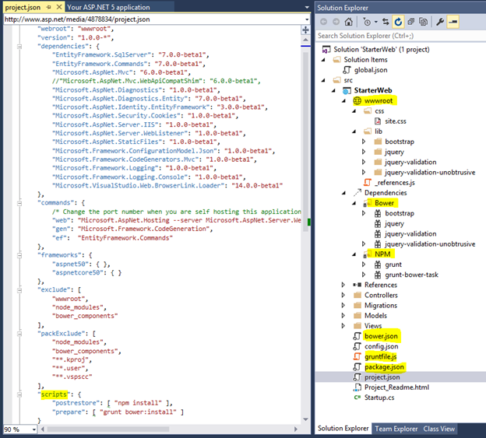
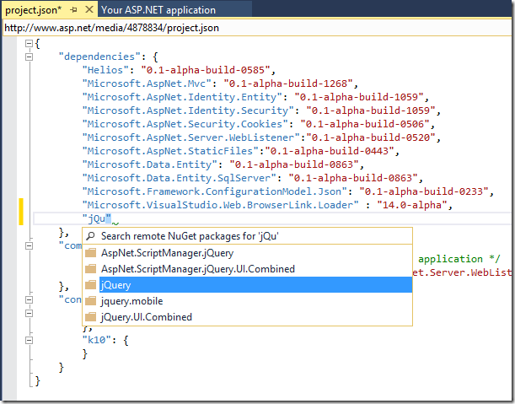
New project template
web.config -> project.json
wwwroot for static files
Intellisense
Dependencies (NuGet packages)
Package versions

Slide 10
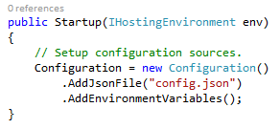
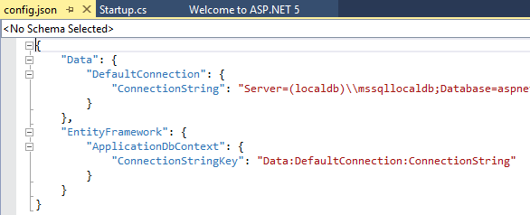
Project configuration

Slide 11
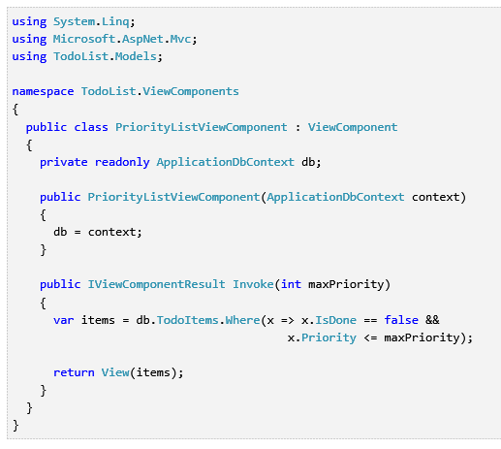
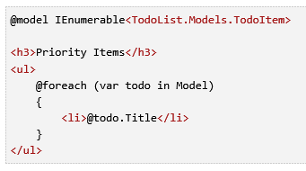

View Components
Partial views replacement
Path
«Views\ControllerName\Components\Component Name»
Examples
Independent components (e.g., tag cloud)

Slide 12
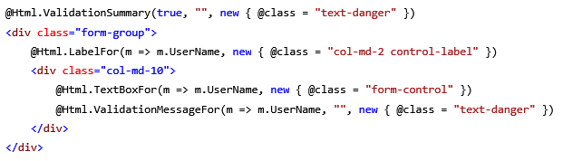
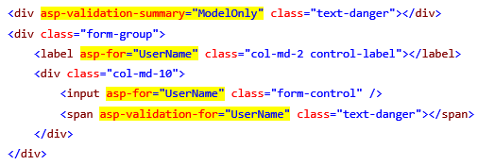
TagHelpers
was
now
Open sourced on GitHub

Slide 13
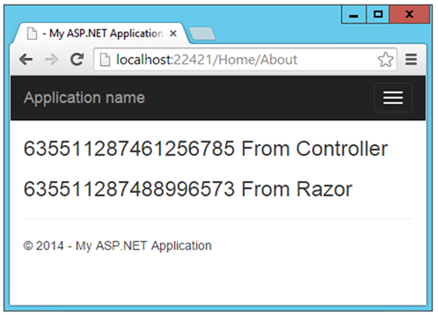
Dependency Injection

Slide 14
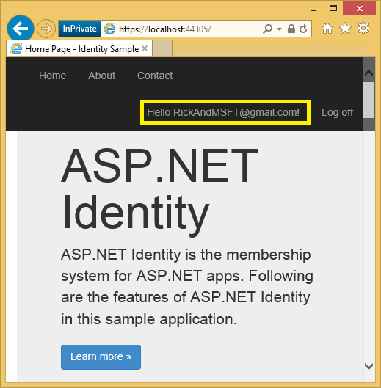
ASP.NET Identity
Single identity system
Web Forms, MVC, SignalR, Web API, …
Web, Phone, Store, hybrid apps
Multi-factor authentication
Different data storages
DB & EF by default. SharePoint, Azure, NoSQL, …
Scheme control
Role management
Claims based authentication
Social networks
Azure Active Directory

Slide 15

Entity Framework 7.0 ORM
Multiple platforms
mobile, OSX, Linux
SQL & noSQL
Azure Table Storage, Redis
Extendable
Open Source
http://github.com/aspnet/entityframework
Roadmap

Slide 16
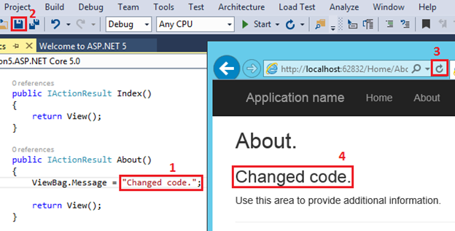
Faster development
Environment detects the changes
Automatic code compilation
You:
1. Make some changes.
2. Save them.
3. Refresh page in browser.
4. Profit!

Slide 17
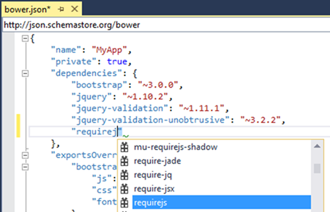
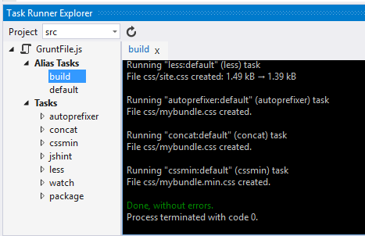
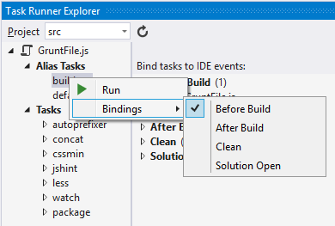
Bower, Grunt, Gulp, npm
Bower configuration
bower.json
Task Runner Explorer
Grunt/Gulp
LESS/SASS-compilation, minification
Running JSHint, JSLint

Slide 18
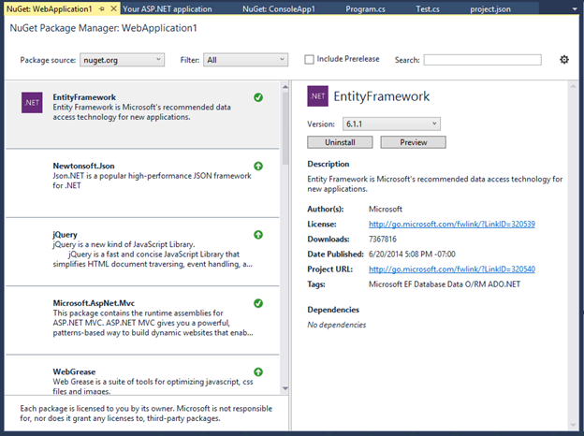
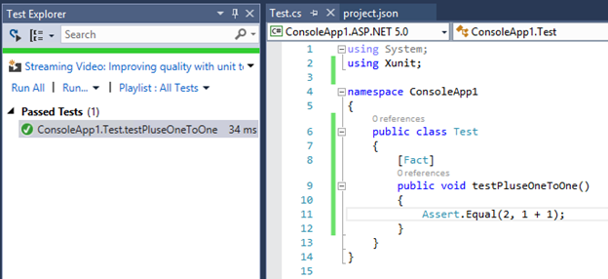
NuGet / xUnit

Slide 19
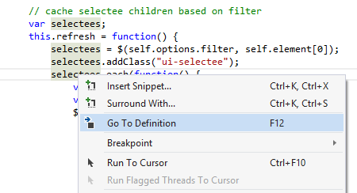
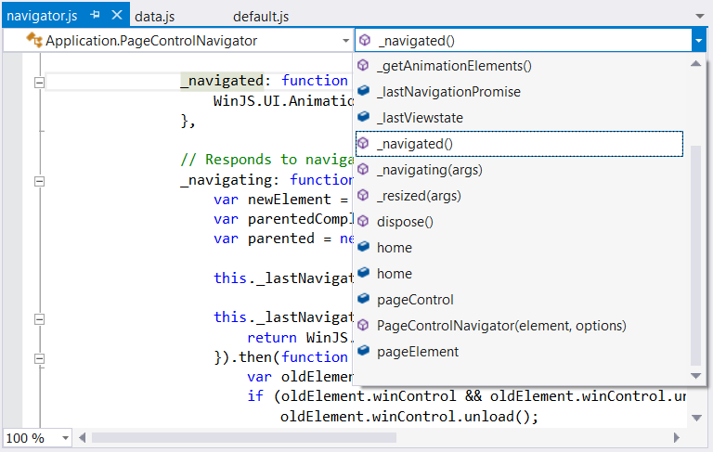

Deep HTML5/JS support
Namespaces support (Go To Definition)
Information about old APIs
IntelliSense for Knockout and AngularJS
TypeScript support
Bootstrap, knockout.js and other libraries from the box
Syntax helpers
Smart formatting
#region in HTML; todo/hack comments

Slide 20
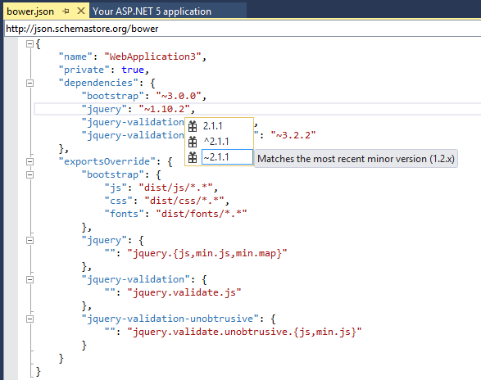
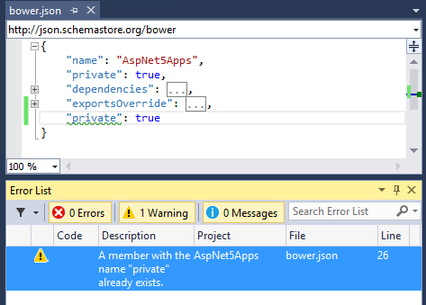
Better JSON Editor
Better intellisense
JSON schemes, validation
Duplicated data detecting
Messages about errors
Unminify

Slide 21
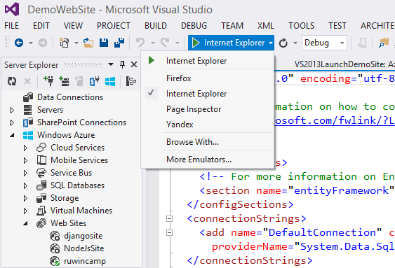
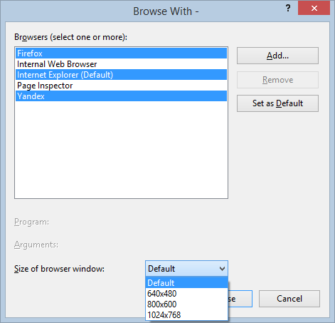
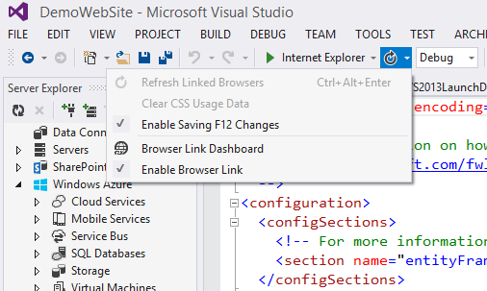
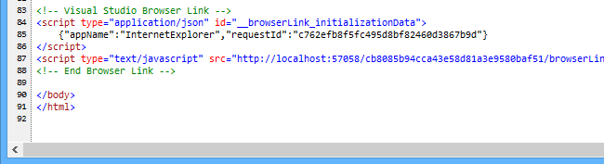
Browser Link
Select multiple browsers
For application testing
Browser Link
Updating page content without refreshing browsers from Visual Studio
Browser Link uses SignalR to create a communication channel between Visual Studio and the browser. When Browser Link is enabled, Visual Studio acts as a SignalR server that multiple clients (browsers) can connect to. Browser Link also registers an HTTP module with ASP.NET. This module injects special <script> references into every page request from the server. You can see the script references by selecting “View source” in the browser.

Slide 22
Application deployment
Local deployment
Azure deployment

Slide 23
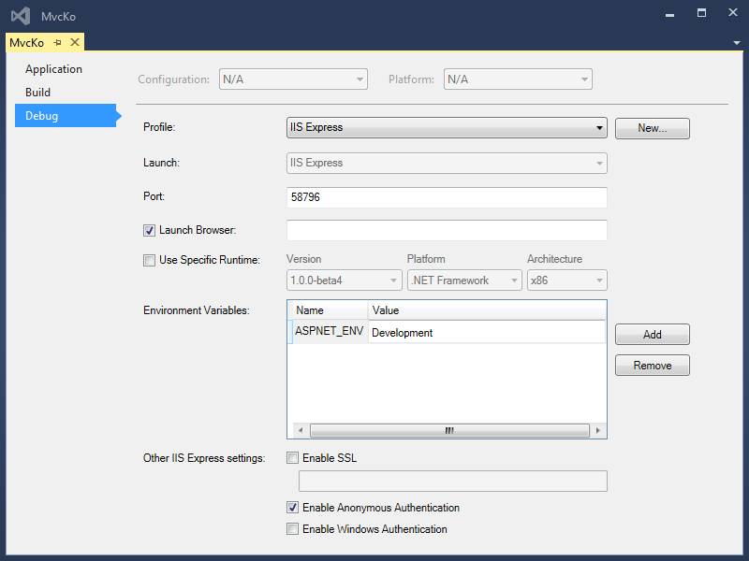
Development/Production environments
<environment names="Development">
<link rel="stylesheet" href="~/lib/bootstrap/css/bootstrap.css" />
<link rel="stylesheet" href="~/lib/bootstrap-touch-carousel/css/bootstrap-touch-carousel.css" />
<link rel="stylesheet" href="~/css/site.css" />
</environment>
<environment names="Staging,Production">
<link rel="stylesheet" href="//ajax.aspnetcdn.com/ajax/bootstrap/3.0.0/css/bootstrap.min.css"
asp-fallback-href="~/lib/bootstrap/css/bootstrap.min.css"
asp-fallback-test-class="hidden" asp-fallback-test-property="visibility" asp-fallback-test-value="hidden" />
<link rel="stylesheet" href="//ajax.aspnetcdn.com/ajax/bootstrap-touch-carousel/0.8.0/css/bootstrap-touch-carousel.css"
asp-fallback-href="~/lib/bootstrap-touch-carousel/css/bootstrap-touch-carousel.css"
asp-fallback-test-class="carousel-caption" asp-fallback-test-property="display" asp-fallback-test-value="none" />
<link rel="stylesheet" href="~/css/site.css" />
</environment>

Slide 24
Deploy ASP.NET project locally
Web servers: IIS, Apache
Package copying, FTP
Web Deploy
Use Web Deploy tool directly from Visual Studio
Self-host

Slide 25
Deploy ASP.NET to the cloud
Microsoft Azure
Virtual Machines, Cloud Services, Web Sites Ability to execute PowerShell script
Built tools for tracing and diagnostics
Event Tracing for Windows, Application Insights
New configuration system
You don’t need web.config any more

Slide 26
Azure configuration
In your host environment, you can set the environmental variables and those values are automatically used instead of local configuration values after the application is deployed. You can deploy your application without worrying about publishing test values.

Slide 27
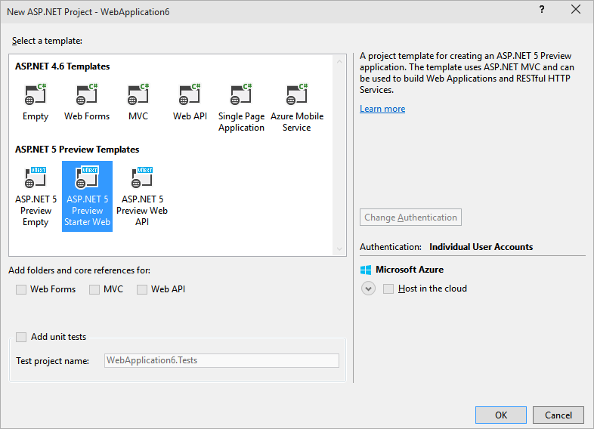
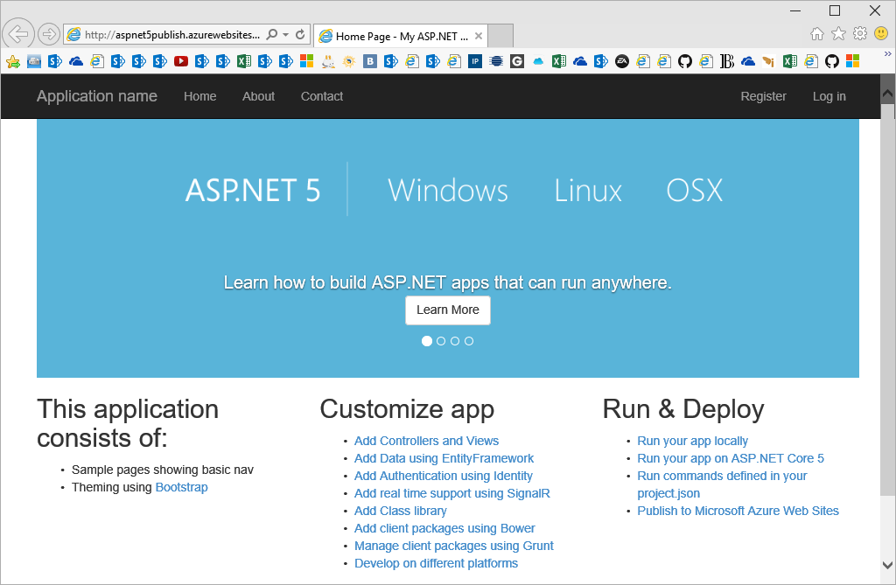
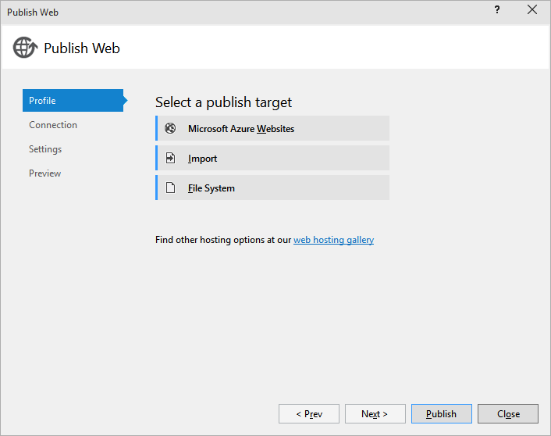
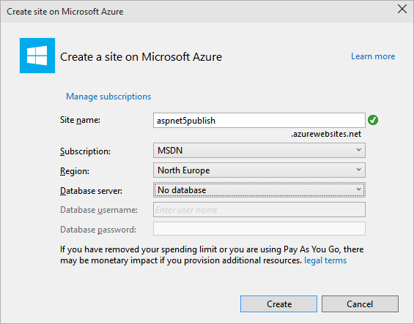
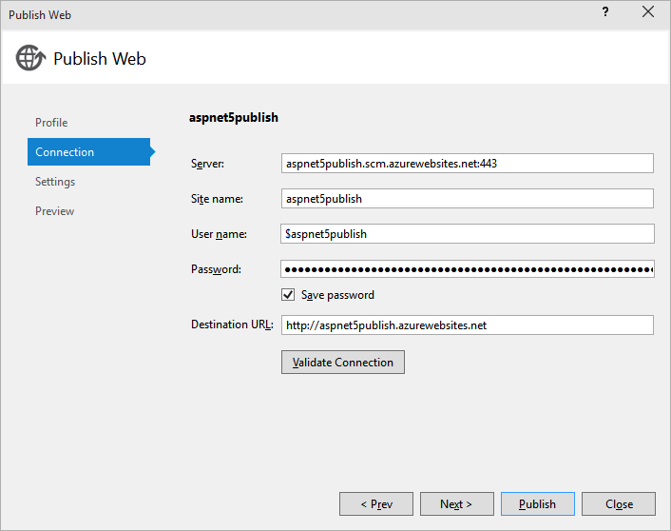
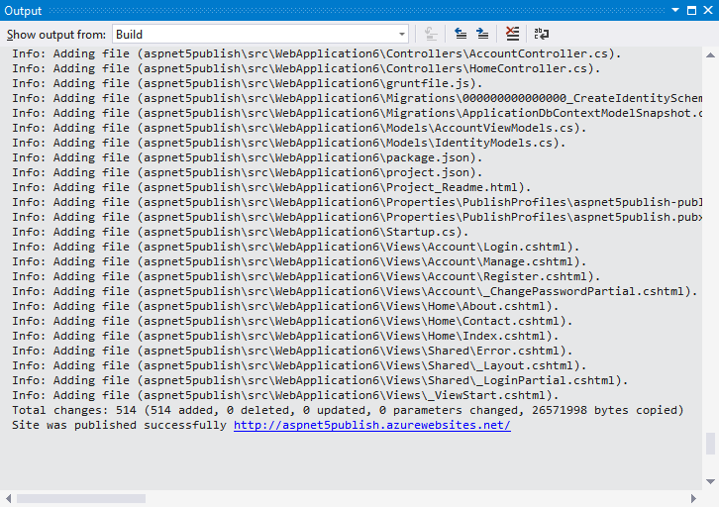
ASP.NET deployment in 2 minutes

Slide 28
ASP.NET for mobile developers
Azure Mobile Services
Ready-to-use cloud backend for your mobile applications
Data, code, push-notifications, authorization, offline-режим etc.
iOS, Android, Windows/WP, Xamarin, HTML5/JS, Cordova/PhoneGap
Free plan
Own REST API: Node.js or .NET
Azure Mobile Services and REST API
ASP.NET Web API
Integration with Visual Studio:
Project template “Azure Mobile Service”
Create, publish, debug remotely
Integration with Git

Slide 29
Cross-platform ASP.NET development
Windows, OSX, Linux
Visual Studio, Sublime

Slide 30
Open Web Interface for .NET
 | Раньше | Сейчас
The host application | ALWAYS Microsoft Internet Information Server (IIS) | This could be IIS, IIS with Helios, Katana, or some other OWIN capable host.
The CLR framework | You would choose which version of the Microsoft.NET framework you wanted to use | This may be .NET 4.5.2, K runtime, or Mono.
Your Application | Separate projects for ASP.NET MVC, Web API and SignalR. | Your application now loads the former ASP.NET frameworks (MVC, WebAPI, or SignalR) as part of its dependencies.

Slide 31
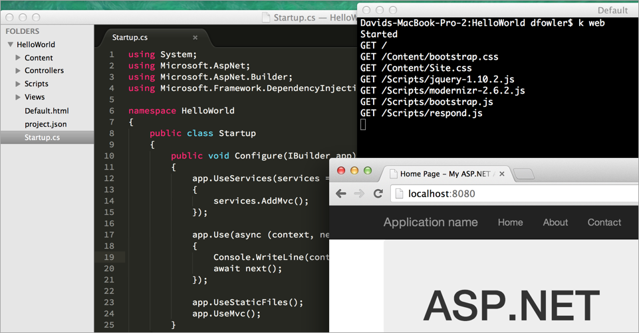
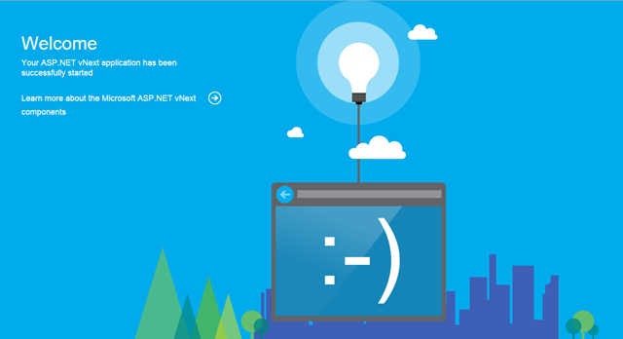
OSX and Linux
ASP.NET 5 supports deployment to OSX and Linux
Working on Mono, with investments from Microsoft
Integrated cross-platform web-server Kestrel
Integration with Sublime3 editor

Slide 32
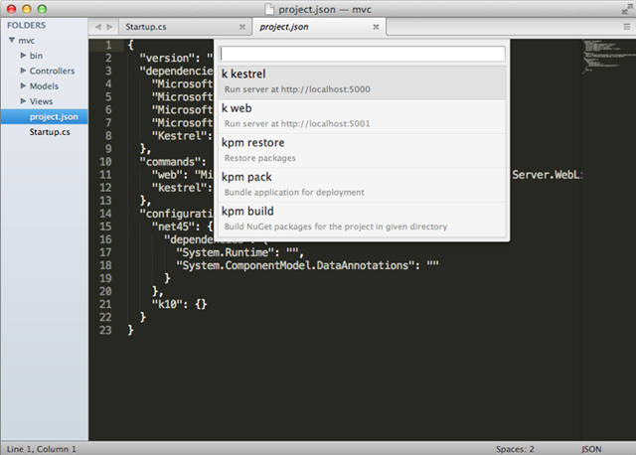
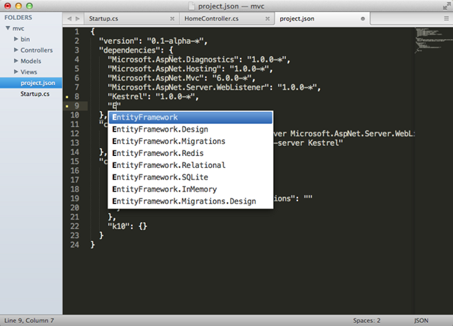
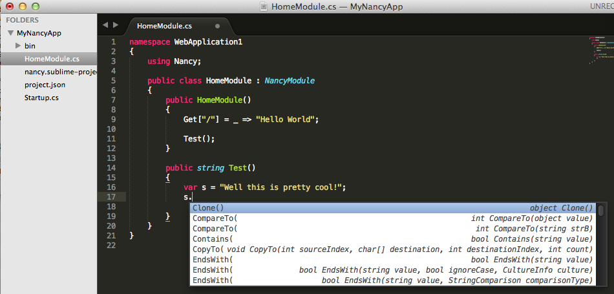
ASP.NET and Sublime
Integration with K command line
Working with compilation errors
Manage dependencies
Intellisense
OmniSharp powered by Roslyn
Open Source

Slide 33

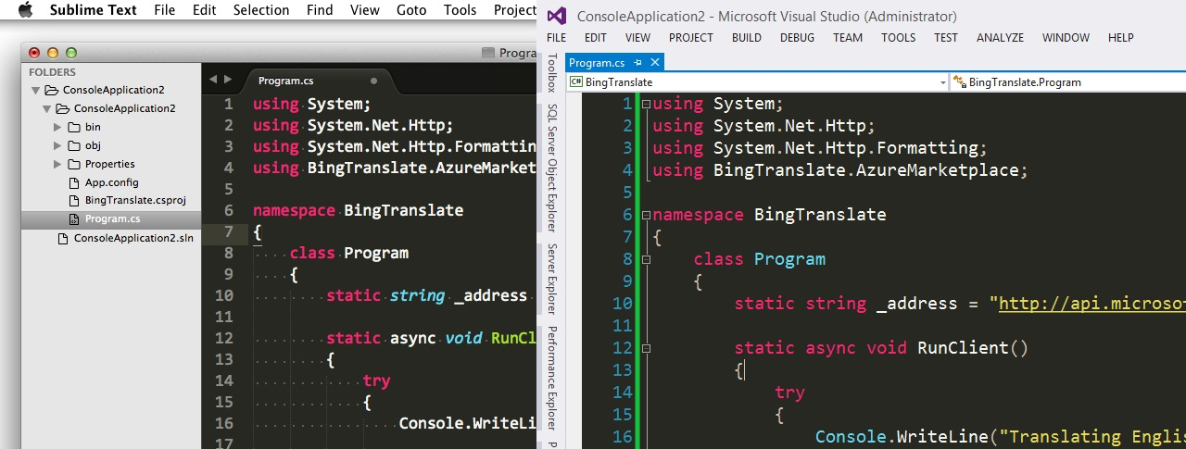
OmniSharp – cross-platform tools for .NET
http://omnisharp.net
IntelliSense
Add Reference
Format Document
Deploy to Azure
…and much more!
Open source & community driven

Slide 34
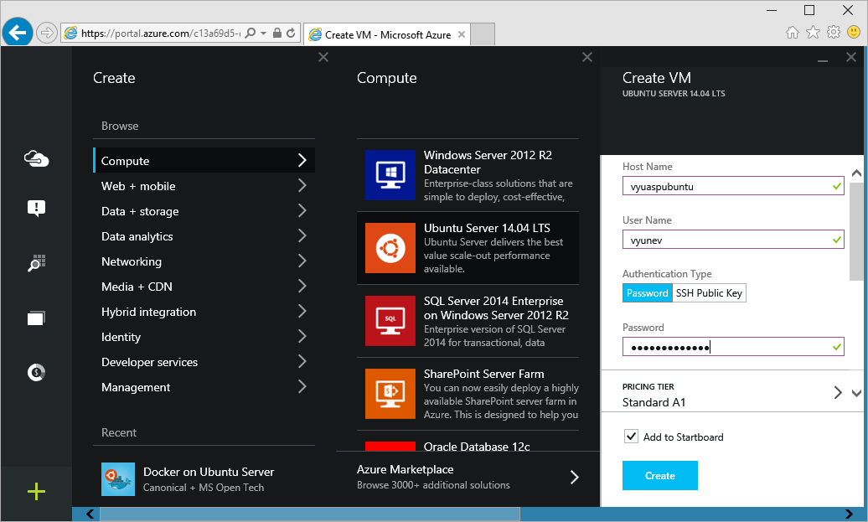
ASP.NET and Linux
Mono runtime
sudo apt-get mono-complete
Install ASP.NET 5
git clone git://github.com/aspnet/home.git sh ~/sources/aspnet5/kvminstall.sh source ~/.k/kvm/kvm.sh kvm upgrade
SSL certificates for Nuget
sudo $CERTMGR -ssl -m https://nuget.org
Web server Kestrel
k kestrel

Slide 35
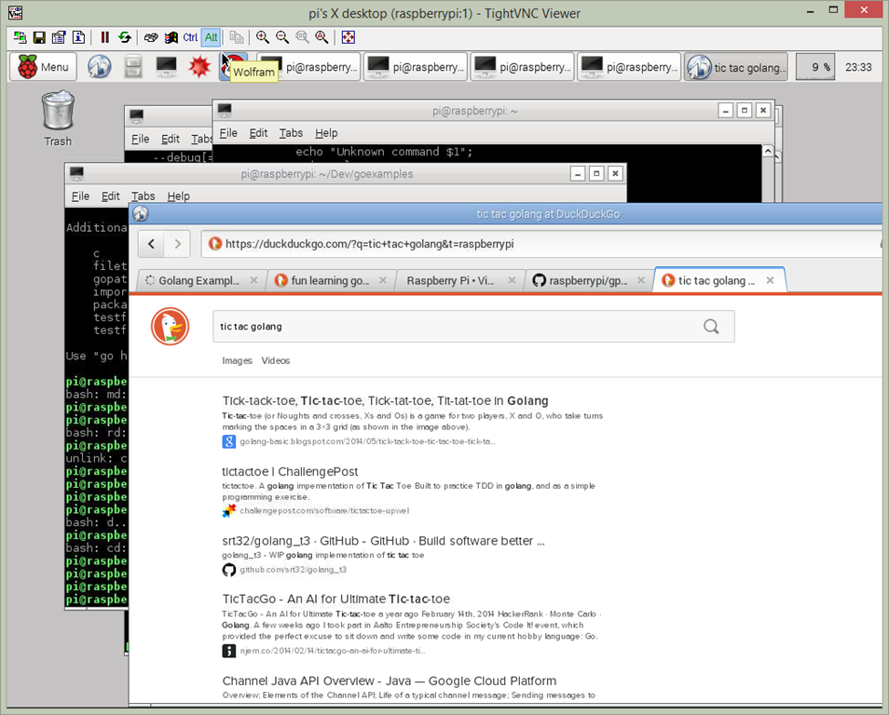
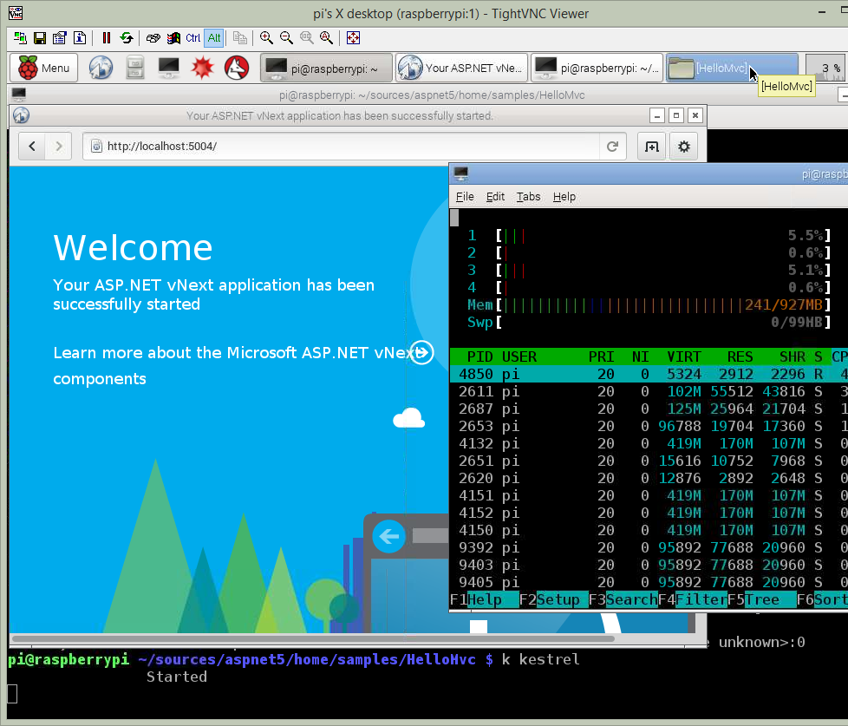
ASP.NET and Raspberry PI
Mono runtime
sudo apt-get mono-complete
Install ASP.NET 5
git clone git://github.com/aspnet/home.git sh ~/sources/aspnet5/kvminstall.sh source ~/.k/kvm/kvm.sh kvm upgrade
SSL certificates for Nuget
sudo $CERTMGR -ssl -m https://nuget.org
Web server Kestrel
k kestrel

Slide 36
ASP.NET and Docker
Docker containers support
Official ASP.NET 5 Docker Image
https://registry.hub.docker.com/u/microsoft/aspnet/
Official Docker Image for Azure
VM Docker on Ubuntu Server

Slide 37
DEMO
Azure Windows 10 VM with Visual Studio 2015
New ASP.NET MVC project
Deploy to Azure Web Sites

Slide 38

Q&A
Oleksandr Krakovetskyi
CEO, DevRain Solutions alex.krakovetskiy@devrain.com @msugvnua http://facebook.com/alex.krakovetskiy http://appclub.im

